Slide 1
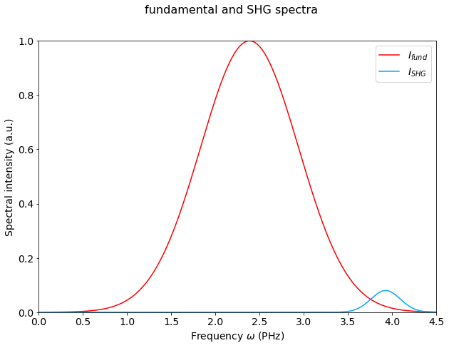
1) gaussian spectra
The fundamental spectrum is a gaussian with 3fs FTL.
The SHG wave is a weaker (att factor 0.08 for the E field) gaussian centered around 480nm with 10fs FTL (random) and carries (at w) twice the spectral phase of the fundamental at w/2

Slide 2
with a GDD of 0fs²
The purple vertical lines indicate the 480 +- 25nm spectral range (assumed Fringeezz spectral range)

Slide 3
with a GDD of 36fs² (eq. 1mm of glass)

Slide 4
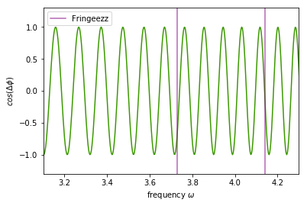
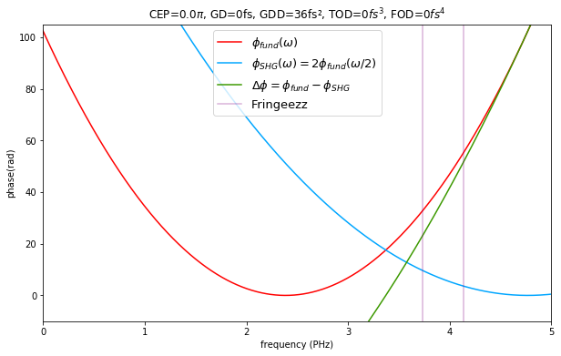
with a GDD of 36fs² (eq. 1mm of glass)

Slide 5
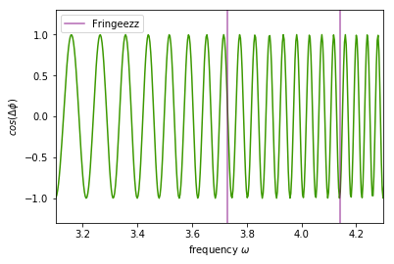
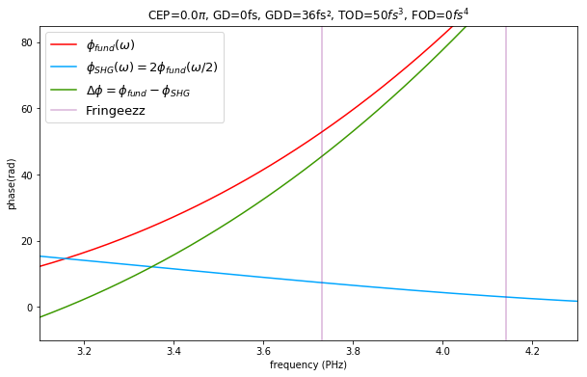
with a GDD of 36fs² (eq. 1mm of glass) and a TOD = 50fs^3
Effect of TOD : the period of the fringes varies along the frequencies axis

Slide 6
with a GDD of 100fs²
about 12 fringes within the Fringeezz spectral range

Slide 7
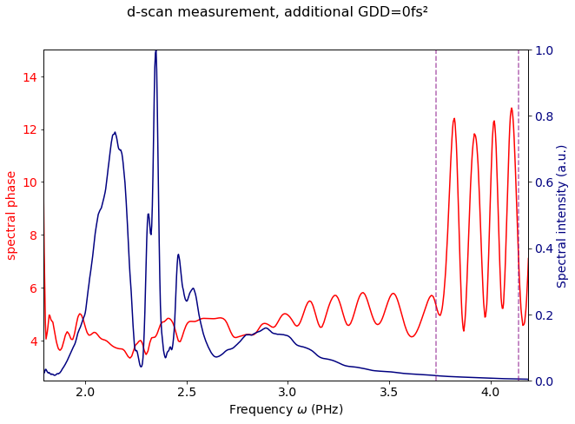
2) Spectral phase and intensity measured by the dscan
No additionnal GDD

Slide 8
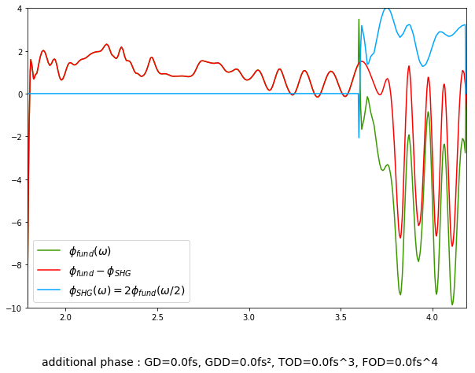
No additionnal GDD
The SHG phase below 3.6PHz is meaningless

Slide 9
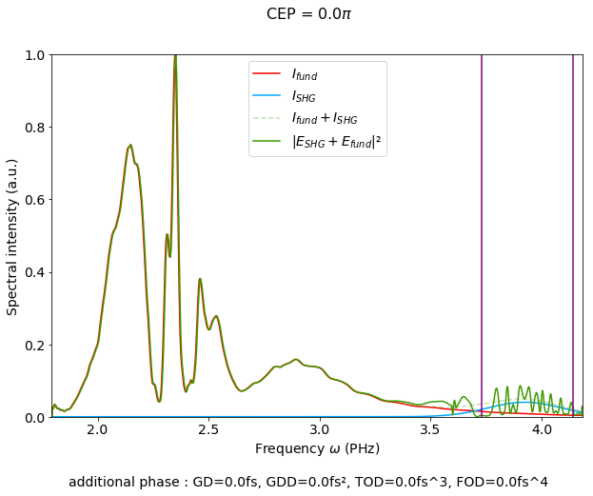
No additionnal GDD
Once again, we just assume that the SHG wave is a weaker gaussian centered around 480nm with a 10fs FTL width and carries (at w) twice the spectral phase of the fundamental at w/2

Slide 10
Let’s only look above 3.6PHz…
No additionnal GDD

Slide 11
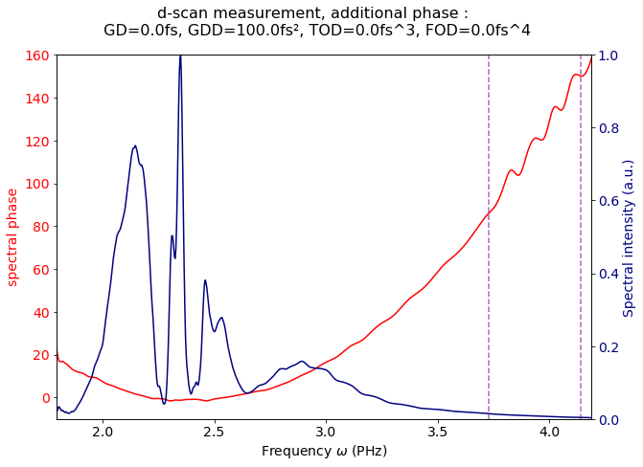
100 fs² additionnal GDD

Slide 12
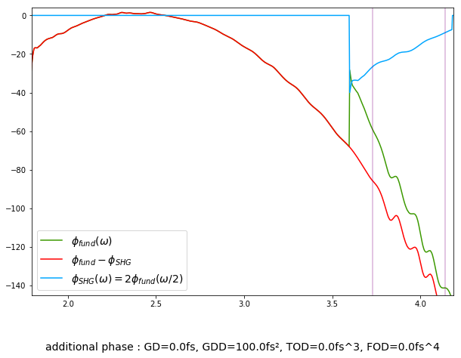
100 fs² additionnal GDD

Slide 13
100 fs² additionnal GDD

Slide 14
Améliorations à apporter :
Spectre SHG en fonction du cristal doubleur ET de l’intensité spectrale du fondamental dans le rouge…

